Slide 1
Operating Systems
Shakila Zaman
Lecturer
Ref:
Dr. Md. Motaharul Islam
Associate Professor
Dept. of CSE, Brac university
Slides source: Silberschatz, Peter B. Galvin, Greg Gagne, "Operating System Concepts", Wiley; 9th edition.

Slide 2
Chapter 2: OS Structures
Operating System Services
System calls
OS design and implementation
Operating system structure

Slide 3
Operating System Services
Operating systems provide an environment for execution of programs and services to programs and users
One set of operating-system services provides functions that are helpful to the user:
User interface - Almost all operating systems have a user interface (UI).
Varies between Command-Line (CLI), Graphics User Interface (GUI), Batch
Program execution - The system must be able to load a program into memory and to run that program, end execution, either normally or abnormally (indicating error)
I/O operations - A running program may require I/O, which may involve a file or an I/O device

Slide 4
Operating System Services (Cont.)
One set of operating-system services provides functions that are helpful to the user (Cont.):
File-system manipulation - The file system is of particular interest. Programs need to read and write files and directories, create and delete them, search them, list file Information, permission management.
Communications – Processes may exchange information, on the same computer or between computers over a network
Communications may be via shared memory or through message passing (packets moved by the OS)
Error detection – OS needs to be constantly aware of possible errors
May occur in the CPU and memory hardware, in I/O devices, in user program
For each type of error, OS should take the appropriate action to ensure correct and consistent computing
Debugging facilities can greatly enhance the user’s and programmer’s abilities to efficiently use the system

Slide 5
Operating System Services (Cont.)
Another set of OS functions exists for ensuring the efficient operation of the system itself via resource sharing
Resource allocation - When multiple users or multiple jobs running concurrently, resources must be allocated to each of them
Many types of resources - CPU cycles, main memory, file storage, I/O devices.
Accounting - To keep track of which users use how much and what kinds of computer resources
Protection and security - The owners of information stored in a multiuser or networked computer system may want to control use of that information, concurrent processes should not interfere with each other
Protection involves ensuring that all access to system resources is controlled
Security of the system from outsiders requires user authentication, extends to defending external I/O devices from invalid access attempts

Slide 6
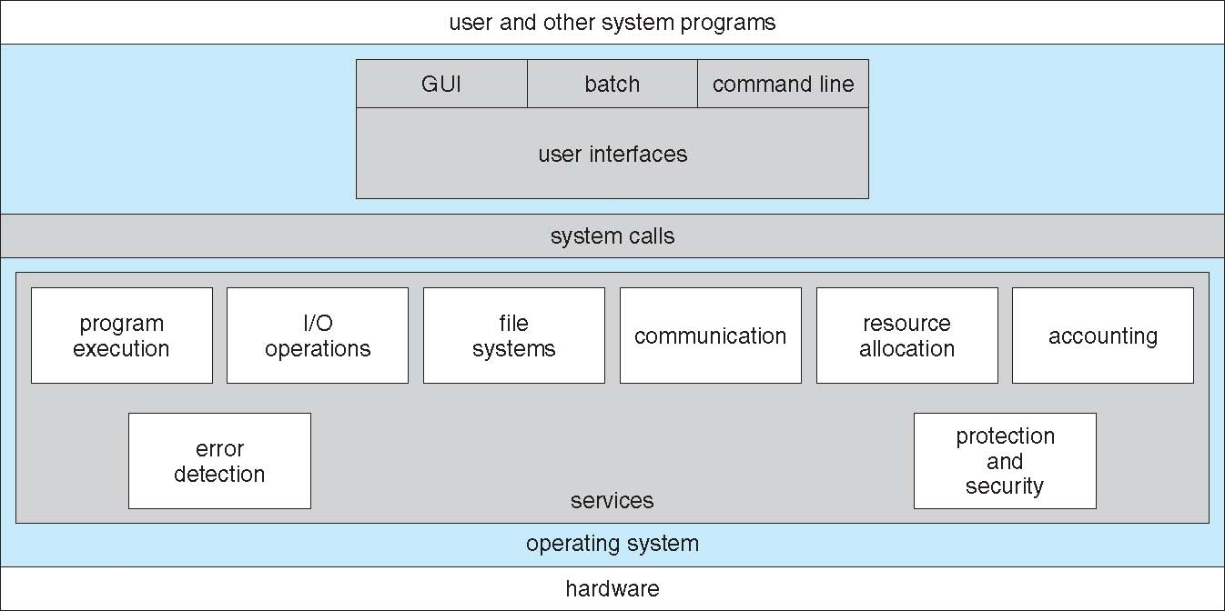
A View of Operating System Services

Slide 7
Process Management
A process is a program in execution. It is a unit of work within the system. Program is a passive entity, process is an active entity.
Process needs resources to accomplish its task
CPU, memory, I/O, files
Initialization data
Process termination requires reclaim of any reusable resources
Single-threaded process has one program counter specifying location of next instruction to execute
Process executes instructions sequentially, one at a time, until completion
Multi-threaded process has one program counter per thread
Typically system has many processes, some user, some operating system running concurrently on one or more CPUs
Concurrency by multiplexing the CPUs among the processes / threads

Slide 8
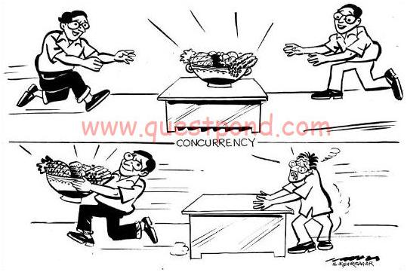
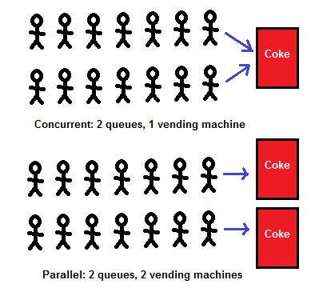
Concurrency

Slide 9
Process Management Activities
The operating system is responsible for the following activities in connection with process management:
Creating and deleting both user and system processes
Suspending and resuming processes
Providing mechanisms for process synchronization
Providing mechanisms for process communication
Providing mechanisms for deadlock handling

Slide 10
Memory Management
To execute a program all (or part) of the instructions must be in memory
All (or part) of the data that is needed by the program must be in memory.
Memory management determines what is in memory and when
Optimizing CPU utilization and computer response to users
Memory management activities
Keeping track of which parts of memory are currently being used and by whom
Deciding which processes (or parts thereof) and data to move into and out of memory
Allocating and deallocating memory space as needed

Slide 11
Storage Management
OS provides uniform, logical view of information storage
Abstracts physical properties to logical storage unit - file
Each medium is controlled by device (i.e., disk drive, tape drive)
Varying properties include access speed, capacity, data-transfer rate, access method (sequential or random)
File-System management
Files usually organized into directories
Access control on most systems to determine who can access what
OS activities include
Creating and deleting files and directories
Primitives to manipulate files and directories
Mapping files onto secondary storage
Backup files onto stable (non-volatile) storage media

Slide 12
Mass-Storage Management
Usually disks used to store data that does not fit in main memory or data that must be kept for a “long” period of time
Proper management is of central importance
Entire speed of computer operation hinges on disk subsystem and its algorithms
OS activities
Free-space management
Storage allocation
Disk scheduling
Some storage need not be fast
Tertiary storage includes optical storage, magnetic tape
Still must be managed – by OS or applications
Varies between WORM (write-once, read-many-times) and RW (read-write)

Slide 13
I/O Subsystem
One purpose of OS is to hide peculiarities of hardware devices from the user
I/O subsystem responsible for
Memory management of I/O including buffering (storing data temporarily while it is being transferred), caching (storing parts of data in faster storage for performance), spooling (the overlapping of output of one job with input of other jobs)
General device-driver interface
Drivers for specific hardware devices

Slide 14
Protection and Security
Protection – any mechanism for controlling access of processes or users to resources defined by the OS
Security – defense of the system against internal and external attacks
Huge range, including denial-of-service, worms, viruses, identity theft, theft of service
Systems generally first distinguish among users, to determine who can do what
User identities (user IDs, security IDs) include name and associated number, one per user
User ID then associated with all files, processes of that user to determine access control
Group identifier (group ID) allows set of users to be defined and controls managed, then also associated with each process, file
Privilege escalation allows user to change to effective ID with more rights

Slide 15
System Calls
In computing, a system call is the programmatic way in which a computer program requests a service from the kernel of the operating system it is executed on.
Programming interface to the services provided by the OS
Typically written in a high-level language (C or C++)
Mostly accessed by programs via a high-level Application Programming Interface (API) rather than direct system call use
Three most common APIs are Win32 API for Windows, POSIX API for POSIX-based systems (including virtually all versions of UNIX, Linux, and Mac OS X), and Java API for the Java virtual machine (JVM)

Slide 16
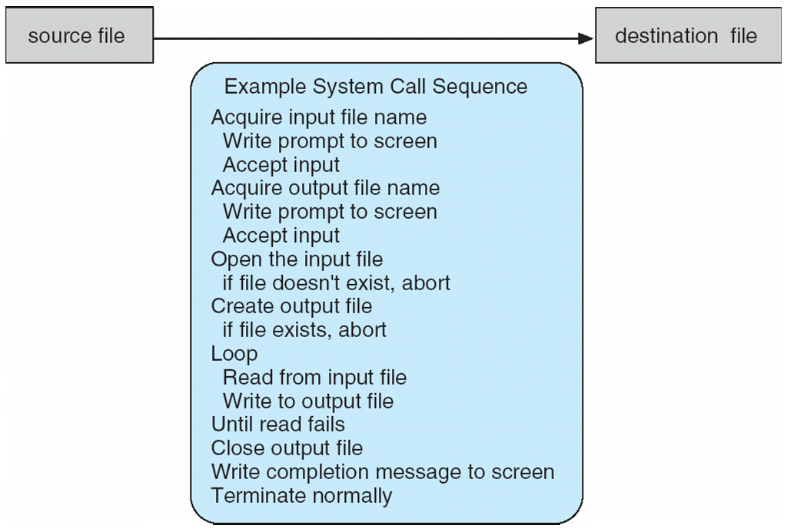
Example of System Calls
System call sequence to copy the contents of one file to another file

Slide 17
System Call Implementation
Typically, a number associated with each system call
System-call interface maintains a table indexed according to these numbers
The system call interface invokes the intended system call in OS kernel and returns status of the system call and any return values
The caller need know nothing about how the system call is implemented
Just needs to obey API and understand what OS will do as a result call
Most details of OS interface hidden from programmer by API
Managed by run-time support library (set of functions built into libraries included with compiler)

Slide 18
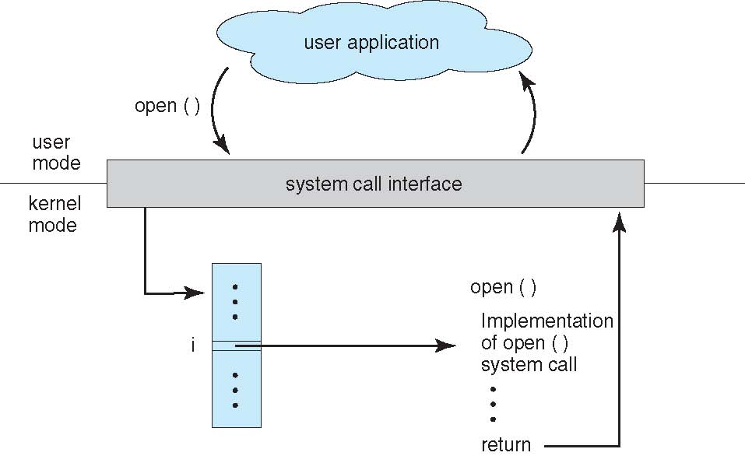
API – System Call – OS Relationship

Slide 19
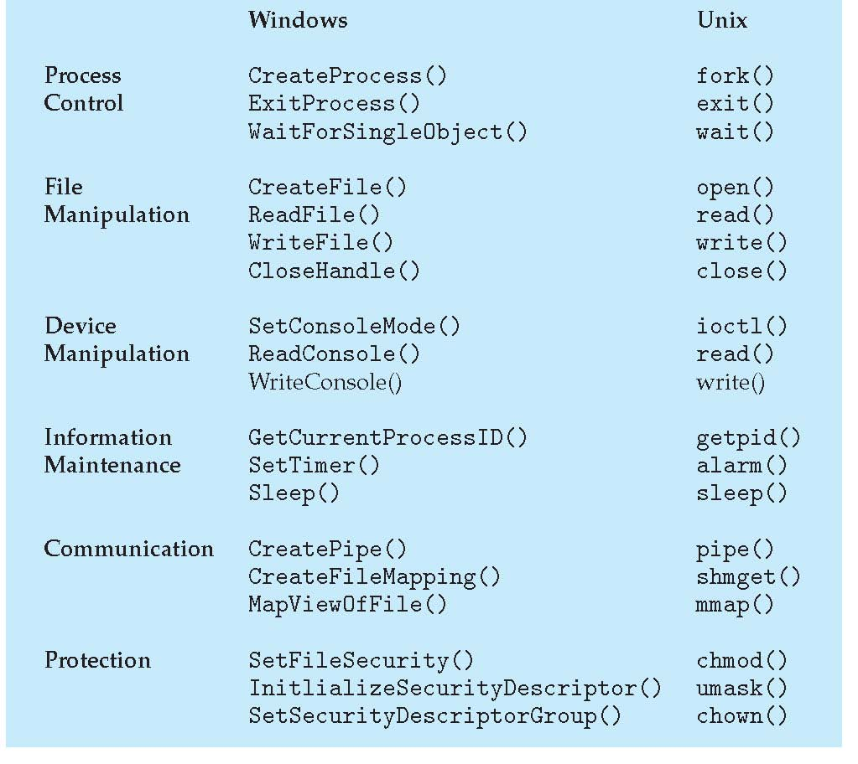
Examples of Windows and Unix System Calls

Slide 20
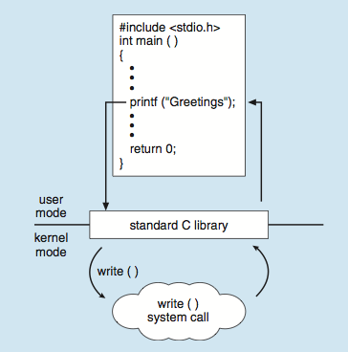
Standard C Library Example
C program invoking printf() library call, which calls write() system call

Slide 21
System Boot
When power initialized on system, execution starts at a fixed memory location
Firmware ROM used to hold initial boot code
Operating system must be made available to hardware so hardware can start it
Small piece of code – bootstrap loader, stored in ROM locates the kernel, loads it into memory, and starts it
Sometimes two-step process where boot block at fixed location loaded by ROM code, which loads bootstrap loader from disk
Common bootstrap loader, GRUB, allows selection of kernel from multiple disks, versions, kernel options
Kernel loads and system is then running
Notes:
Till here for 9am 639

Slide 22
Summary
Operating System Services
System calls
OS design and implementation
Operating system structure

Slide 23
Next Topic
Processes: Process Concept, Process Scheduling, Operations on Processes, Inter-process Communication – Within a system, Communication in Client-Server Systems – Between systems
Reading: Book Chapter 3: Processes

